Slide 1
movie industry analysis
File created on: 02/05/2025 1:30:49 pm GMT+5

Slide 2
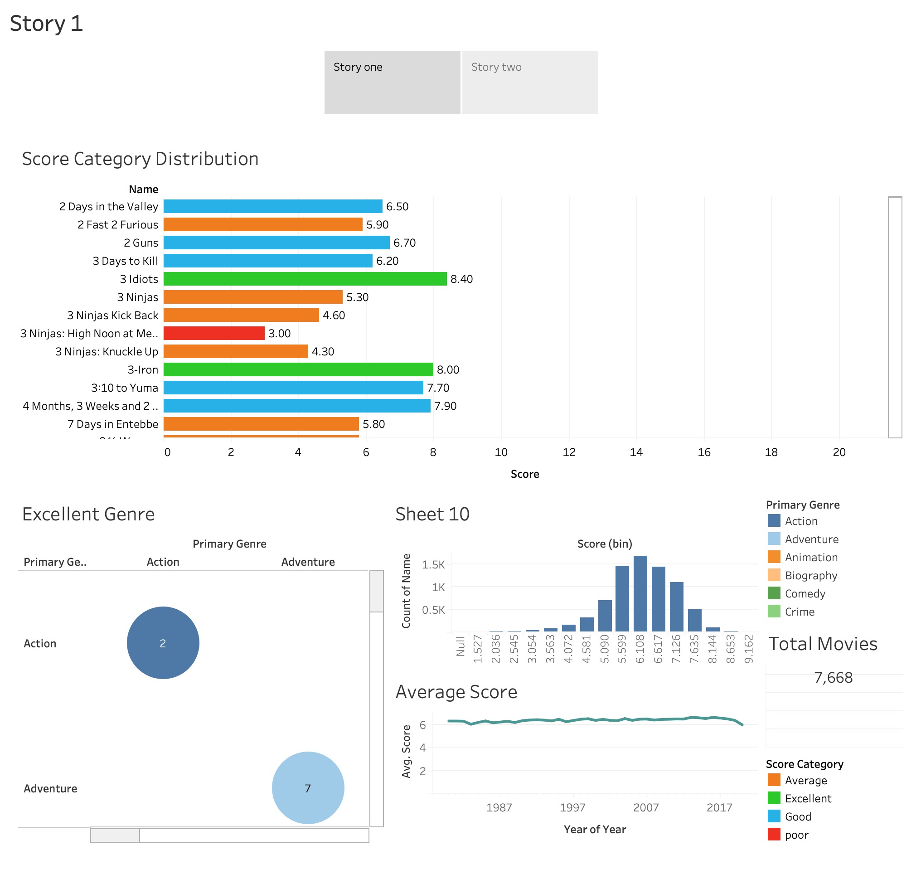

Slide 3
